Slide 1

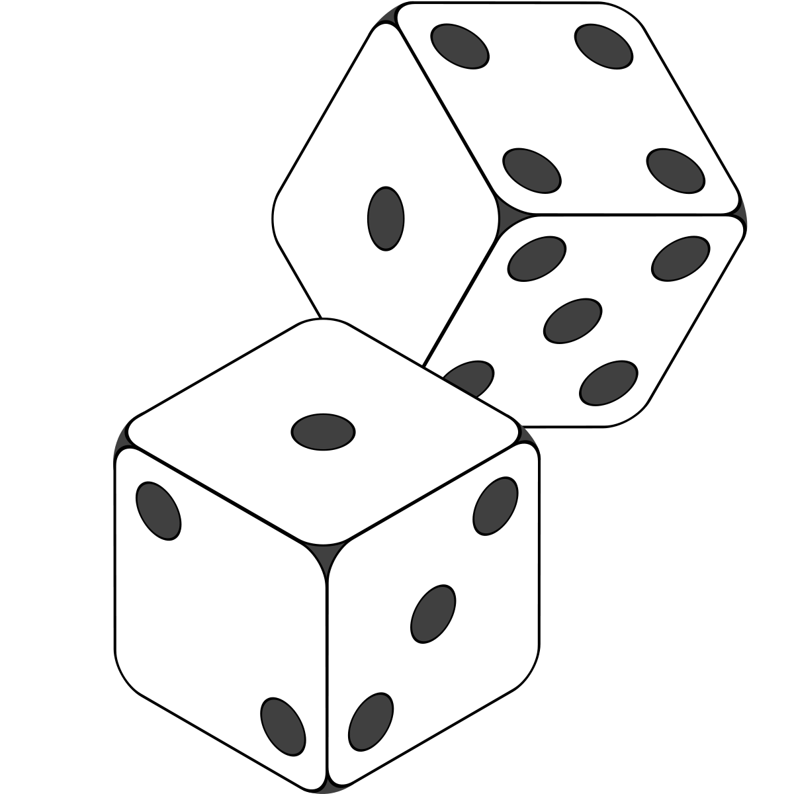
Random Variables
Experiment: Doing something and looking at the result; e.g. rolling a die
Event: the result of an experiment; e.g. for a die {1}, {2}, …, {6]
A random variable is a variable whose value is unknown or a function that assigns values to each of an experiment's outcomes.
Can be either discrete (having specific values) or continuous (any value in a continuous range).
Most commonly used in probability and statistics, where they are used to quantify outcomes of random occurrences.
Represent the possible outcomes of a yet-to-be-performed experiment, or the possible outcomes of a past experiment whose already-existing value is uncertain

Slide 2
Probability Principles
Probability: Share of Success/Total # possible outcomes | Similar to relative frequency
In terms of Game of Dice:
The exact outcome cannot be predicted
All possible outcomes are known.
Equally likely outcomes.
Repeatable under uniform conditions. The game must be repeatable under uniform conditions
Regularity or Proportion: Together, the above conditions produce a certain regularity in the sense that patterns for the results or outcomes can be observed
http://uregina.ca/~gingrich/ch61.pdf https://bolt.mph.ufl.edu/6050-6052/unit-3/module-6/

Slide 3
Probability Rules
1. Probability Rule #1 states:
For any event A, 0 ≤ P(A) ≤ 1
2. Probability Rule #2 states:
The sum of the probabilities of all possible outcomes is 1 ( Rule of Subtraction)
3. The Complement Rule (#3) states that
P(not A) = 1 – P(A)
4. The General Addition Rule (#5) states that for any two events,
P(A or B) = P(A) + P(B) – P(A and B),
where, by P(A or B) we mean P(A occurs or B occurs or both).In the special case of disjoint events, events that cannot occur together, the General Addition Rule can be reduced to the Addition Rule for Disjoint Events (#4), which is
P(A or B) = P(A) + P(B).
5. The Multiplication rule: P(A and B) = P(A)* P(B/A) or P(B)* P(A/B)
If A and B are events whose outcome does not affect the other (Independent), we can reduce the formula to
P( A and B) = P(A)* P(B)

Slide 4
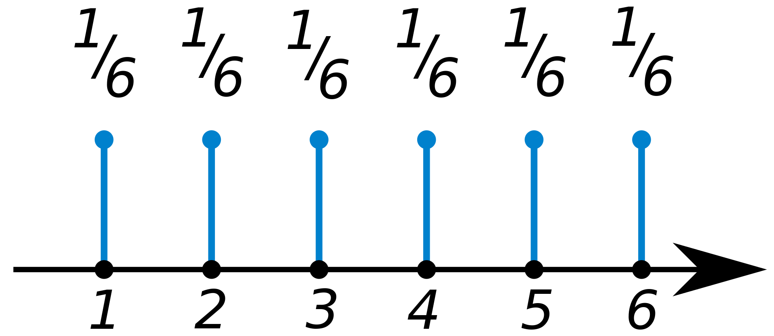
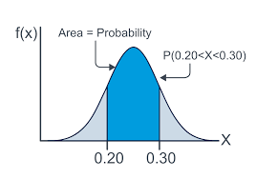
Probability Dist Function
The probability distribution for a random variable describes how the probabilities are distributed over the values of the random variable.
For a discrete random variable, x, the probability distribution is defined by a probability mass function, denoted by f(x).
Whereas for continuous it is defined by Probability density function

Slide 5
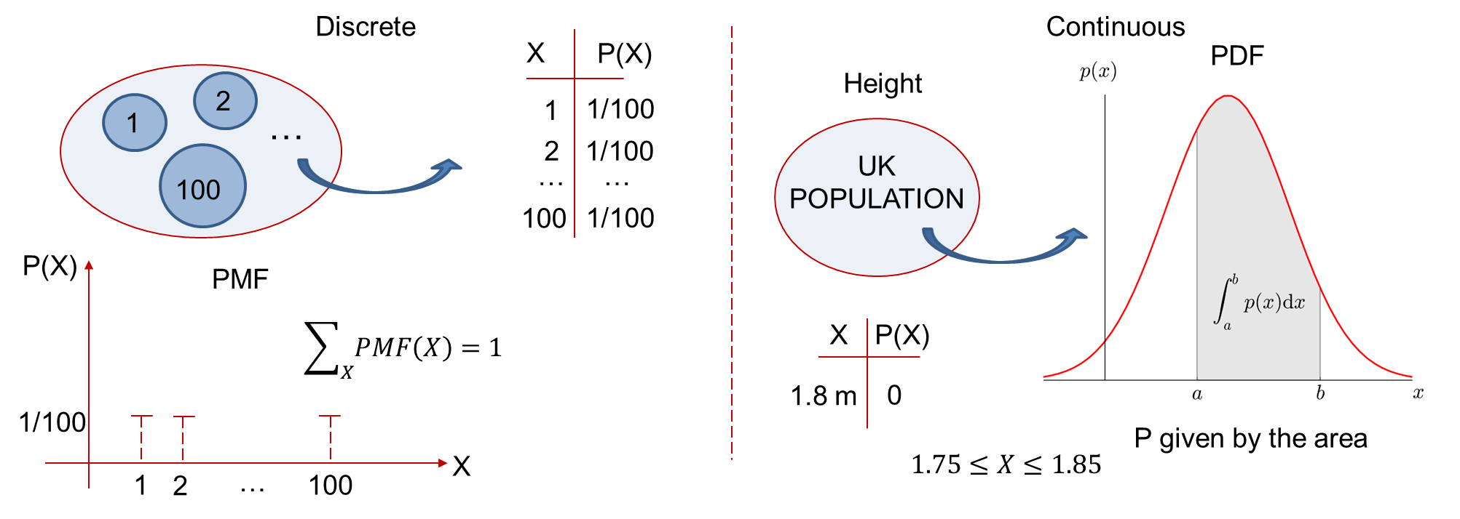
Probability Dist Function

Slide 6

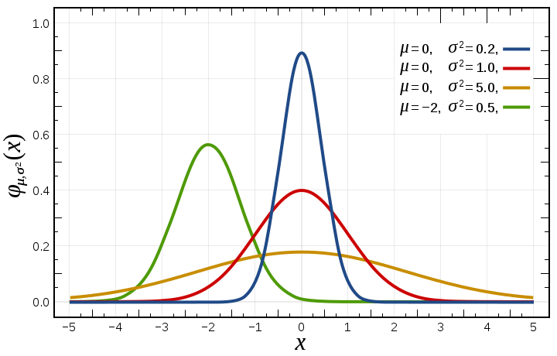
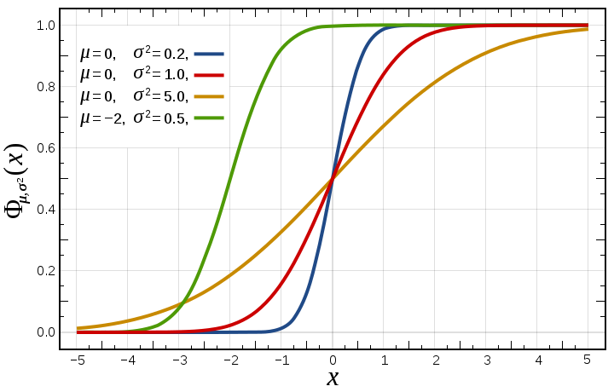
Cumulative Dist Function
Cumulative Distribution function is obtained by summation of all the prob values upto a particular limit, and an be expressed as the integral of its probability density function as follows

Slide 7
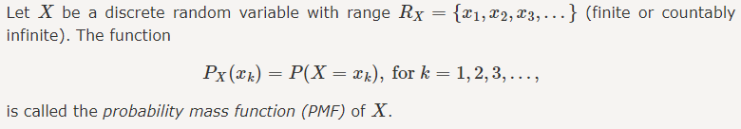
Probability Mass Function
Uniform Distribution: When the chances of every possible outcome is same. Ex: Rolling of Dice
Bernoulli distribution: Bernoulli distribution, Ber(p), is used to model an experiment with only two possible outcomes. The two outcomes are often encoded as 1 and 0. Ex:tossing a coin
Binomial distribution: models the number of successes when someone draws n times with replacement. Each draw or experiment is independent, with two possible outcomes.
Geometric distribution and Poison’s distribution
Two rules of PMF
0<=f(x)<=1
∑f(xi) = f(x1) + f(x2) + … = 1

Slide 8
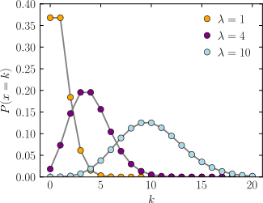
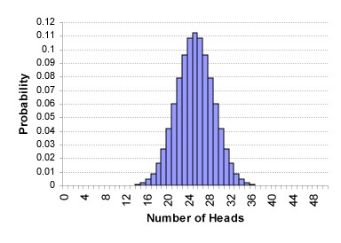
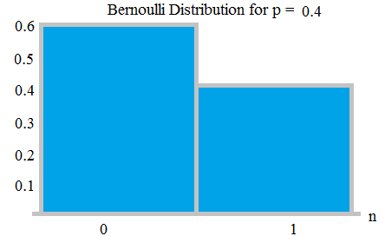
Probability Mass Function

Slide 9
Probability Density Function
The PDF is used to specify the probability of the random variable falling within a particular range of values, as opposed to taking on any one value.
Absolute likelihood for a continuous random variable to take on any particular value is 0
Given by the area under the density function but above the horizontal axis and between the lowest and greatest values of the range. The probability density function is nonnegative everywhere, and its integral over the entire space is equal to 1
Types: Normal distribution, T-distribution, Chi Square Distribution and F Distribution

Slide 10
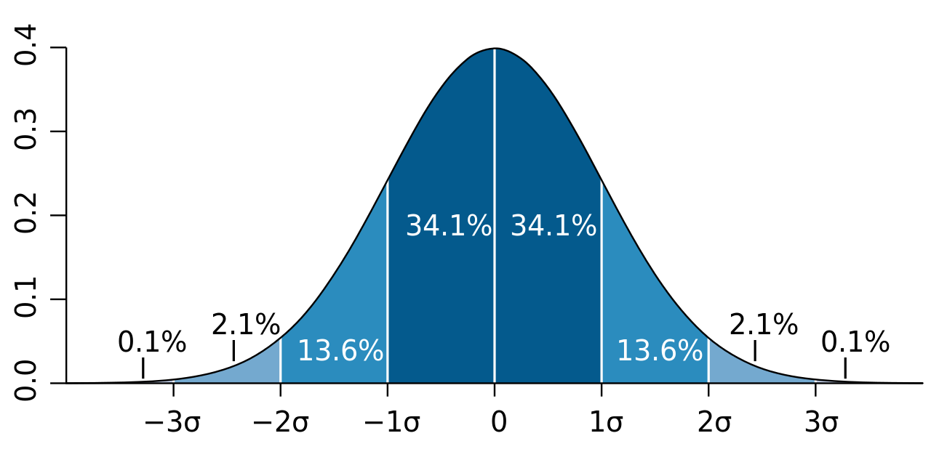
Normal Distribution
Mean = Median = Mode | Symmetry about the center | 50% of values less than the mean and 50% greater than the mean
68-95-99.7 Rule : 68% of values are within 1 standard deviation of the mean, 95% within 2 and 99.7 within 3 SD
Mean, Std Dev, Skewness, Kurtosis of Normal distribution????

Slide 11
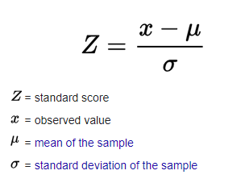
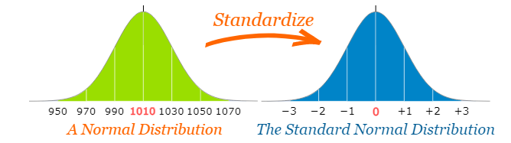
Normal Distribution
The number of standard deviations from the mean is also called the "Standard Score", "sigma" or "z-score“
To convert a value to a Standard Score ("z-score"):: first subtract the mean, then divide by the Standard Deviation, And doing that is called "Standardizing":

Slide 12
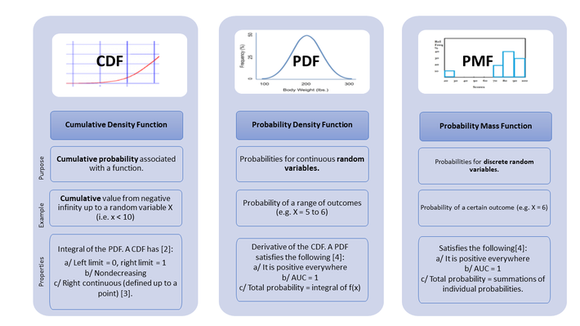
Some More Concepts

Slide 13
Bayes Theorem
In probability theory and statistics, Bayes' theorem (alternatively Bayes' law or Bayes' rule) describes the probability of an event, based on conditions that might be related to the event.
Bayesian inference is a method of statistical inference in which Bayes' theorem is used to update the probability for a hypothesis as evidence.
It Involves:
Posterior Probability: A revised Probability based on additional information.
➢ P(A | B), a conditional probability, is the probability of observing event A given that B is true.
Prior Probability: The initial Probability based on the present level of information.
➢ P(A) is the probabilities of A without regard to B.

Slide 14
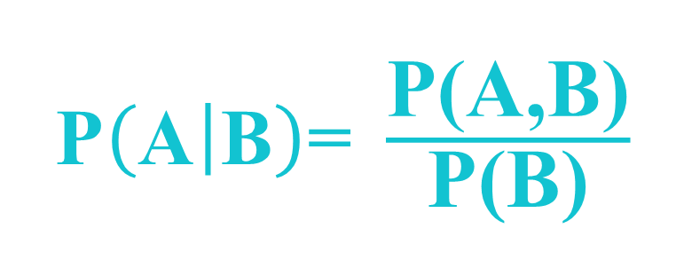
Conditional Probability
What is the probability of A occurring, given that B has occurred?
Probability of A given B?

Slide 15
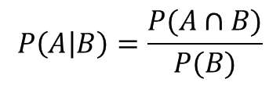

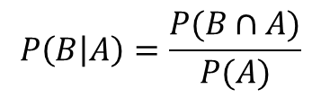


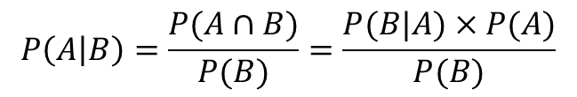
Derivation
Bayes’ theorem
$$P\left(A | B\right)=\frac{P(B|A)×P(A)}{P(B)}$$
$$P\left(A | B\right)=\frac{P(A∩B)}{P(B)}=\frac{P(B|A)×P(A)}{P(B)}$$
$$P\left(A | B\right)=\frac{P(A∩B)}{P(B)}$$
1
$$P\left(B | A\right)=\frac{P(B∩A)}{P(A)}$$
$$P\left(B | A\right)=\frac{P(B∩A)}{P(A)}=\frac{P(A∩B)}{P(A)}$$
2
$$P\left((A∩B\right))=P\left(B | A\right)×P(A)$$

Slide 16

Bayes Theorem
Likelihood
Prior
Posterior
$$P\left(θ | D\right)= \frac{P\left(D | θ\right) × P\left(θ\right) }{P\left(D\right)}$$
Evidence
How good are our parameters given the data
Prior knowledge is incorporated and used to update our beliefs about the parameters
Notes:
16

Slide 17
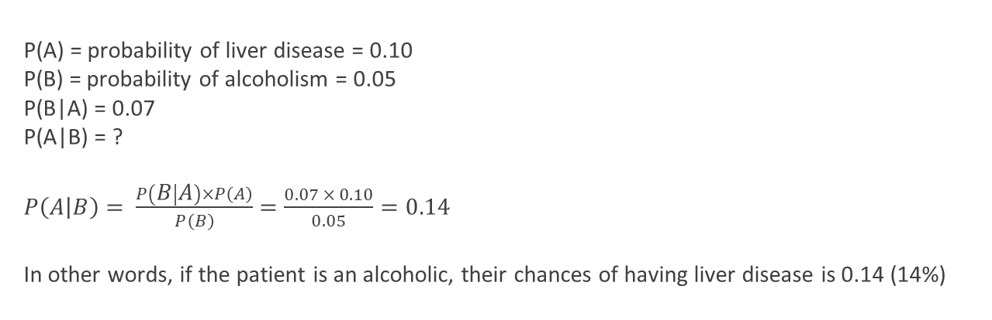
Example
10% of patients in a clinic have liver disease. Five percent of the clinic’s patients are alcoholics. Amongst those patients diagnosed with liver disease, 7% are alcoholics. You are interested in knowing the probability of a patient having liver disease, given that he is an alcoholic.
P(A) = probability of liver disease = 0.10
P(B) = probability of alcoholism = 0.05
P(B|A) = 0.07
P(A|B) = ?
$P\left(A | B\right)= \frac{P\left(B | A\right)×P\left(A\right)}{P\left(B\right)}=\frac{0.07 × 0.10}{0.05}=0.14$
In other words, if the patient is an alcoholic, their chances of having liver disease is 0.14 (14%)

Slide 18
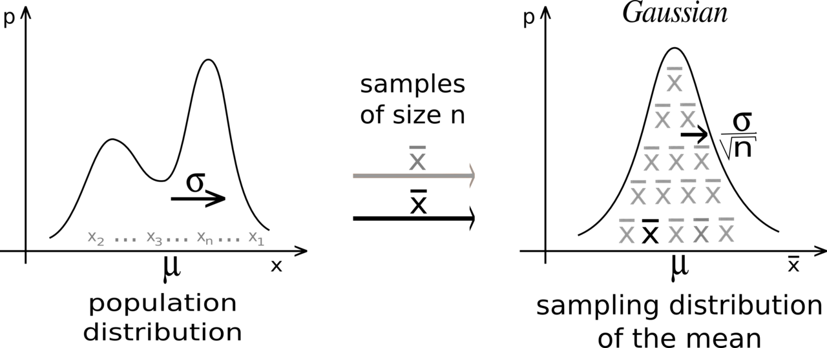
Central Limit Theorem
The central limit theorem states that if you have a population with mean μ and standard deviation σ and take sufficiently large random samples from the population with replacement , then the distribution of the sample means will be approximately normally distributed
It implies that probabilistic and statistical methods that work for normal distributions can be applicable to many problems
Gen if SS GE 30 Then we can assume the distribution to be normal
http://www.ltcconline.net/greenl/java/Statistics/clt/cltsimulation.html

Slide 19
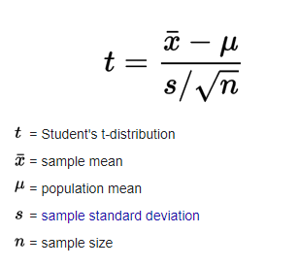
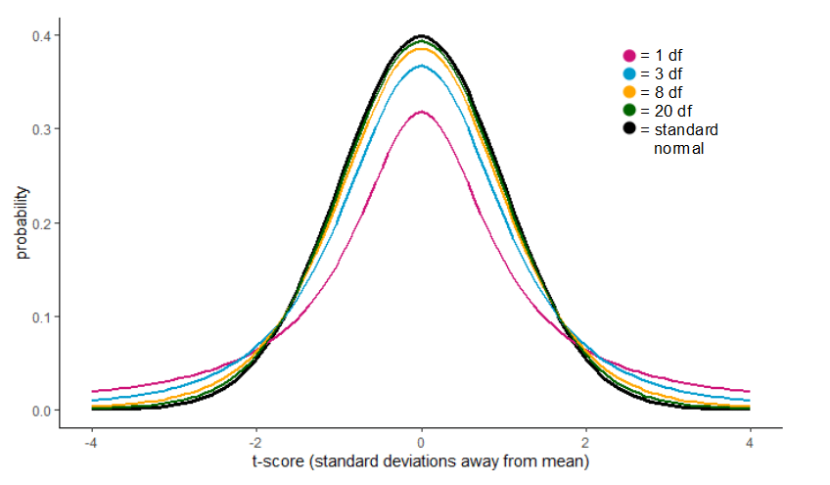
T Distribution
Derived from Normal Distribution
The t-distribution describes the standardized distances of sample means to the population mean when the population standard deviation is not known, and the observations come from a normally distributed population.

